Slide 1

Governance of Cloud-hosted Web Applications
Dissertation by Hiranya Jayathilaka
12/02/2016
- PhD Committee -
Dr. Chandra Krintz (Chair)
Dr. Rich Wolski
Dr. Tevfik Bultan

Slide 2
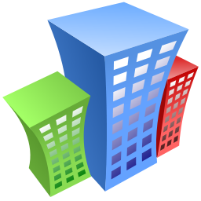


Cloud Computing
Applications
Scalability
High availability
Productivity enhancement
Programming Platforms
Infrastructure Resources
Notes:
Define “Managed”
Managed by the cloud provider (experts)

Slide 3





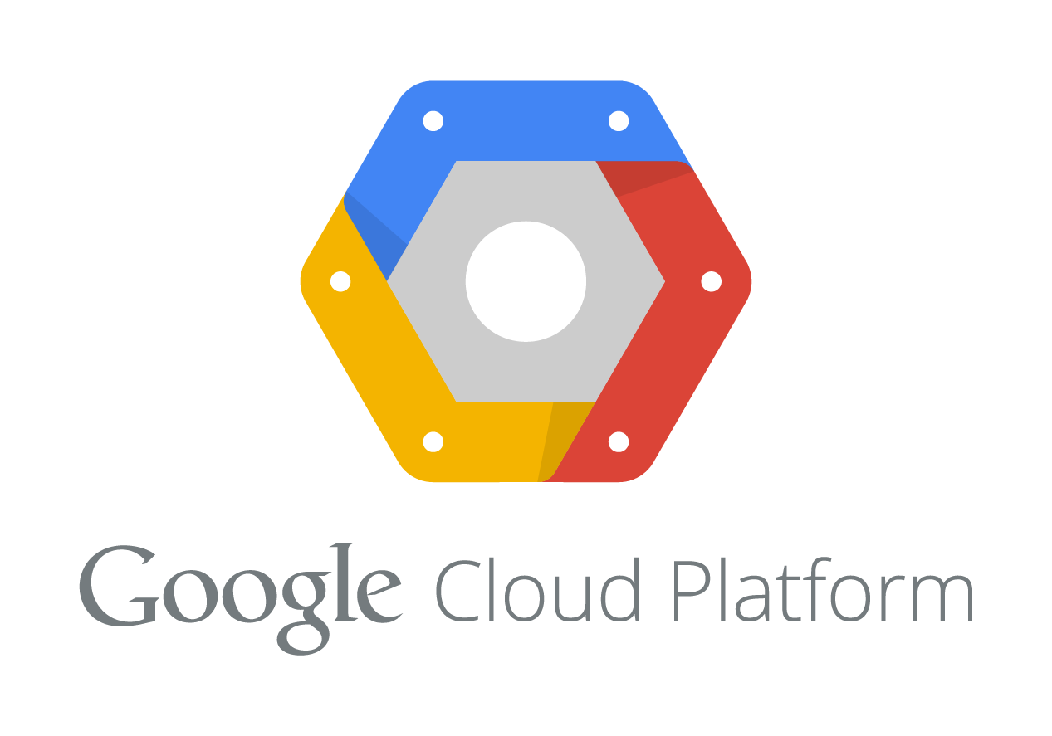















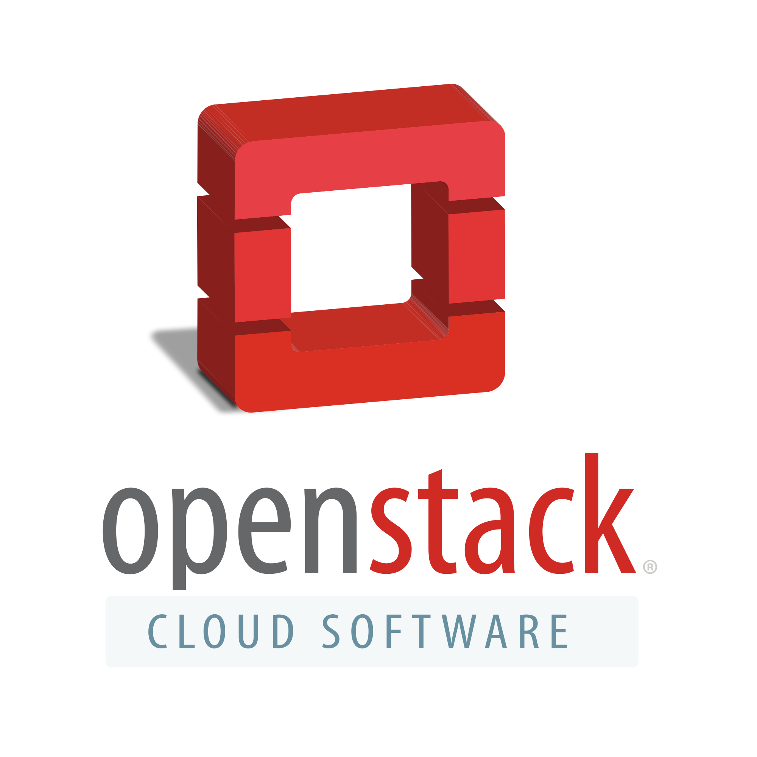

Aftermath
ISBCC
CloudCom
IJCCSA
SSC
HotCloud
IC2E
MobileCloud
SC2
UCC
CCGRID
SOSeMC
FiCloud
HPDC
CSCloud
Notes:
Animation

Slide 4

Challenge 1: Enforcing Developer Best Practices
Cloud platforms speed up development cycles
But no verification or oversight
Code reuse
Naming and versioning conventions
Other organizational standards and best practices (administrative conformance)
Maintenance nightmare
Unverified/unchecked deployment
Poorly implemented application
Notes:
Challenge Number
Don’t use “Cannot”
Good news, bad news scenario

Slide 5
Challenge 2: Performance SLOs
A bound on application’s response time that enables:
Reasoning about downstream app performance
Application monitoring for consistent operation
Negotiating SLAs
No reliable and systematic means for stipulating such bounds
Notes:
Cloud cannot guarantee the response time of applications
Cloud provider doesn’t write the applications

Slide 6

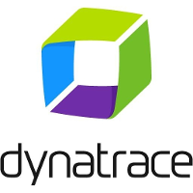

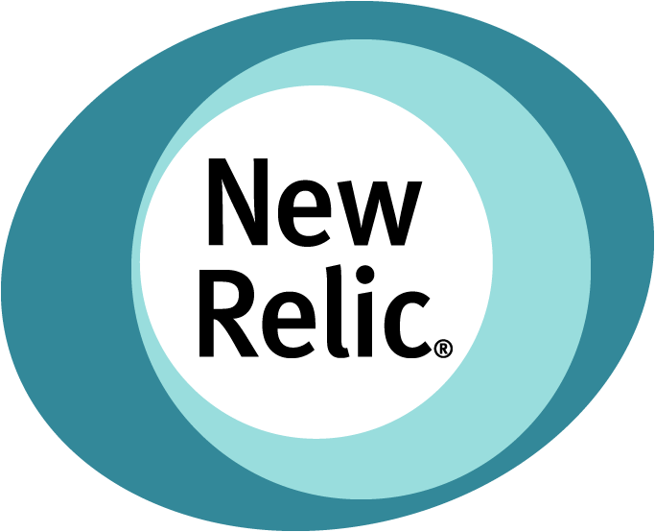
Challenge 3: Performance Debugging
Rudimentary monitoring features only
Spawned a new business for cloud application monitoring
Limited support for anomaly detection and bottleneck identification
Notes:
Don’t mention SLOs here

Slide 7
Governance for Cloud-hosted Web Applications
Governance: Mechanism by which the acceptable operational parameters are specified and maintained in a system
Specification
Enforcement
Monitoring & Notification
Efficient: Non-invasive, Low overhead
Automated: Without human intervention

Slide 8
Thesis Question
Can we efficiently enforce governance for cloud-hosted web applications to achieve administrative conformance, developer best practices, and performance SLOs through automated analysis and diagnostics?
Notes:
Can we enforce design-time governance on web applications developed for a given cloud platform so as to ensure proper versioning, dependency management and conformance to other developer best practices, and also enforce run-time governance on them so as to automatically determine the expected runtime performance of the applications, detect SLA violations and detect performance anomalies and perform root cause analysis, with minimal developer intervention and no invasive instrumentation on the applications?
----- Meeting Notes (4/14/16 14:44) -----
can we define and enforce efficient policies that govern administrative conformance, developer best practices, and performance objectives through automated analysis and diagnostics for cloud applications?
- governance
- automated
- efficient: non-invasive, simple, productivity enhancing

Slide 9
Research Contributions
Low-overhead governance framework for cloud platforms that enforces best practices via policies
Methodology for automatically stipulating performance SLOs for cloud applications
Monitoring framework for detecting performance SLO violations, and diagnosing root causes

Slide 10
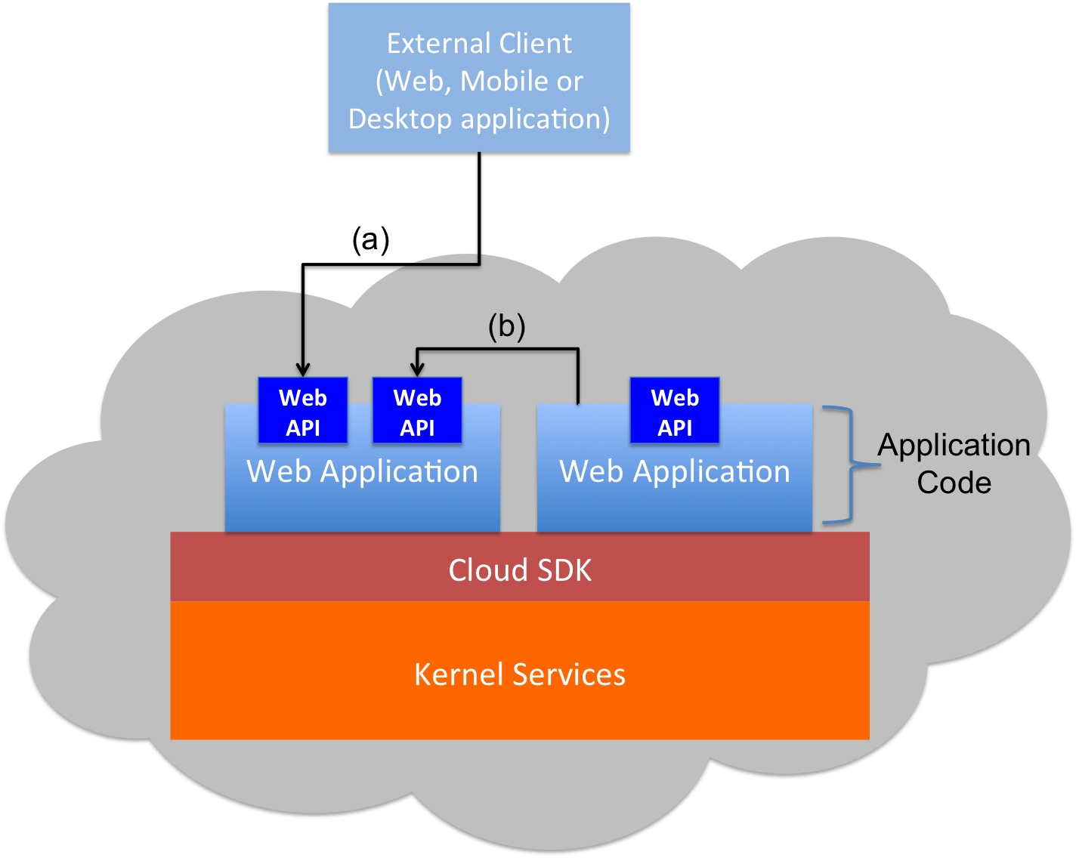

Cloud Platform-as-a-Service (PaaS)
Managed programming platform that hides infrastructure, VM and OS details
Upload
(Deployment-time)
Web Application
PaaS Kernel Services
Notes:
PaaS in the title
PaaS Kernel Services
SDK provides a uniform way to access kernel services.
SDK is used when both developing and executing
Example kernel services (icons)

Slide 11
Research Contributions
Low-overhead governance framework for cloud platforms that enforces best practices via policies
Methodology for automatically stipulating performance SLOs for cloud applications
Monitoring framework for detecting performance SLO violations, and diagnosing root causes

Slide 12
EAGER
Enforced API Governance Engine for REST
A model and an architecture for facilitating governance as a native feature in PaaS clouds
Fine grained control over applications and their APIs
Facilitates comprehensive policy enforcement at deployment-time of web applications
C. Krintz, H. Jayathilaka, S. Dimopoulos, A. Pucher, R. Wolski and T. Bultan, "Cloud Platform Support for API Governance,” IEEE IC2E Future of PaaS workshop 2014.
H. Jayathilaka, C. Krintz and R. Wolski, "EAGER: Deployment-Time API Governance for Modern PaaS Clouds,” IEEE IC2E Future of PaaS workshop 2015.
Notes:
Eager stands for…
Built right into the PaaS cloud, providing governance as a native feature (like another basic service provided by the cloud)
Provides fine grained control – can enforce policies on applications, or their individual APIs
Deployment-time enforcement providing low overhead during runtime and fail fast semantics

Slide 13
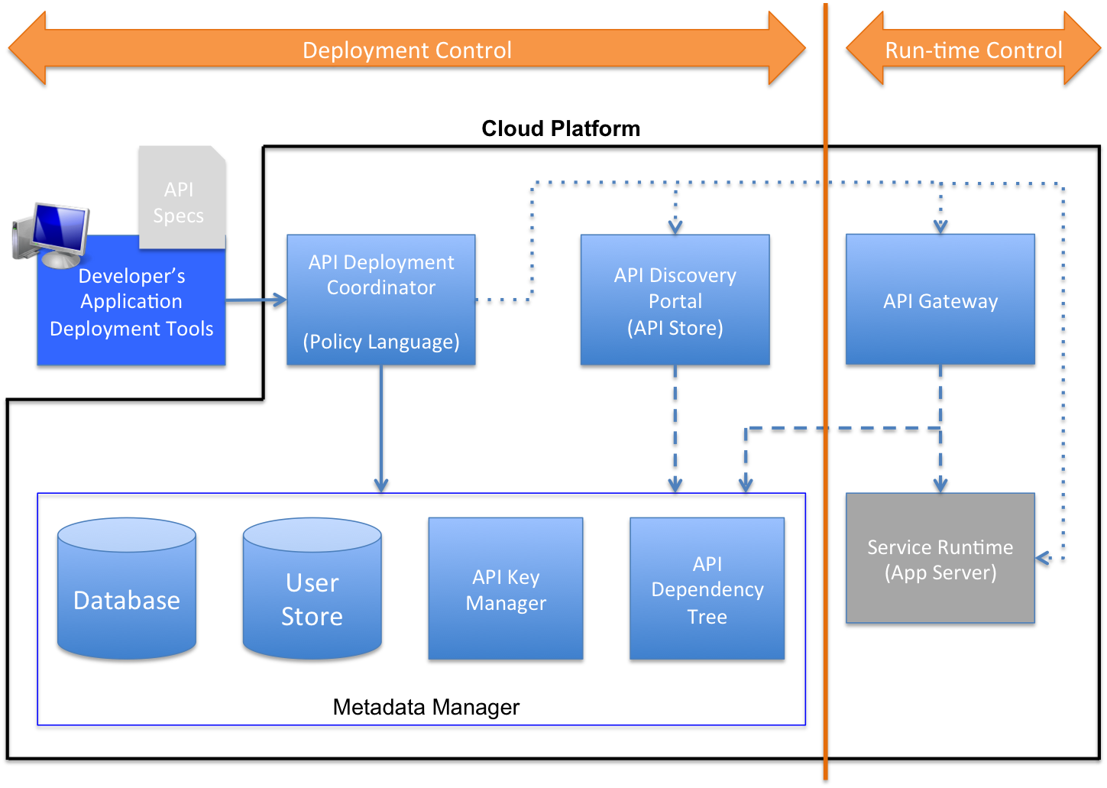
EAGER Architecture
Notes:
Each box is a logical component with many physical instances
Runtime governance vs deployment-time governance (do as much as possible at deployment-time)

Slide 14
Policy Language
Based on Python
Easy to learn and use
Works with existing tools and interpreters
More flexibility and expressive power
Easy to regulate
Policy conditions are expressed using assertion functions

Slide 15
Policy Examples
g = filter(lambda dep: dep.name == ‘Geo’, app.dependencies) d = filter(lambda dep: dep.name == ‘Direction’, app.dependencies)
if g and d: g_api, d_api = g[0], d[0] if compare_versions(g_api.version, ‘3.0’) >= 0:
assert_true(compare_versions(d_api.version , ‘4.0’) >= 0)
if app.owner.endswith(‘engineering.test.com’):
assert_app_dependency (app , ‘Log’, ‘1.0’)
elif app.owner.endswith(‘sales.test.com’): assert_app_dependency (app , ‘AnalyticsLog’, ‘1.0’)
else: assert_app_dependency(app, ‘GenericLog’, ‘1.0’)
Notes:
How is application metadata read?
App is a logical variable made available to all policies.
It gets populated by reading the application deployment descriptors and API description files.
API description files are auto-generated at application compilation.

Slide 16
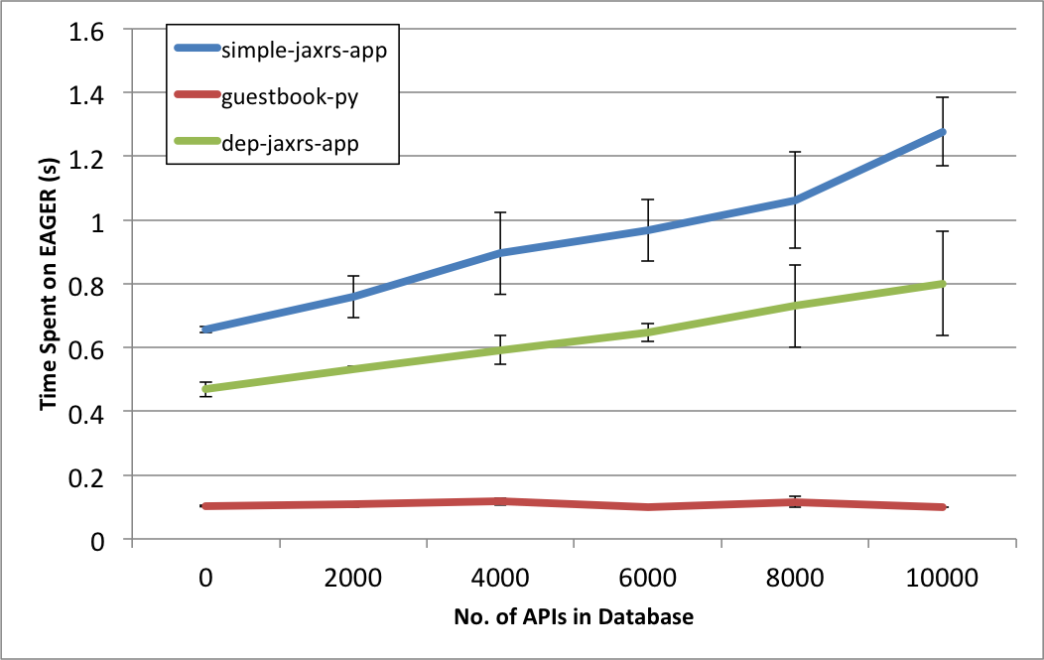
EAGER Overhead vs Applications
Results from a 4-node AppScale private cloud.
Notes:
Describe the goal of the experiment
Explain how the database was populated, Describe axis
Specify AppScale cloud
10000 “other” APIs

Slide 17
EAGER Results Summary
Policy enforcement overhead per application
Less than 1s
Increase in policy enforcement overhead
Less than 100ms for 1000 policies
No significant change in overhead due to the number of dependencies
Notes:
Other experimental findings…

Slide 18
Research Contributions
Low-overhead governance framework for cloud platforms that enforces best practices via policies
Methodology for automatically stipulating performance SLOs for cloud applications
Monitoring framework for detecting performance SLO violations, and diagnosing root causes

Slide 19
Cerebro
Predicts the response time of web APIs developed for PaaS
Interactive APIs developed using the PaaS SDK
Fully automatic & no code instrumentation
Uses a combination of static analysis and continuous platform monitoring
Provides a statistical framework for forming and invalidating performance SLOs
H. Jayathilaka, C. Krintz and R. Wolski, “Response Time Service-Level Agreements for Cloud-hosted Web Applications”, 2015 ACM Symposium on Cloud Computing (SOCC)
H. Jayathilaka, C. Krintz and R. Wolski, "Service-Level Agreement Durability for Web Service Response Time," 2015 IEEE 7th International Conference on Cloud Computing Technology and Science (CloudCom)
Notes:
Cerebro predicts response time bounds for web APIs developed for a PaaS cloud.
It is done using a combination of static analysis on the web API code, and monitoring of the PaaS kernel services.
Mechanism is fully automated, and does not require instrumentation or performance testing of web API code.
Now right off the bat: Cerebro doesn’t support arbitrary applications. Interactive web APIs developed using the PaaS SDK.
Such applications have special properties: Few branches and loops, spends most time executing kernel services.
In some cloud platforms like Google App Engine the platform also enforces a hard deadline on application requests for scalability reasons.
Therefore these applications are more amenable to….
In addition to the SLO prediction, we also devise a statistical framework to detect when a predicted SLO becomes invalid.

Slide 20
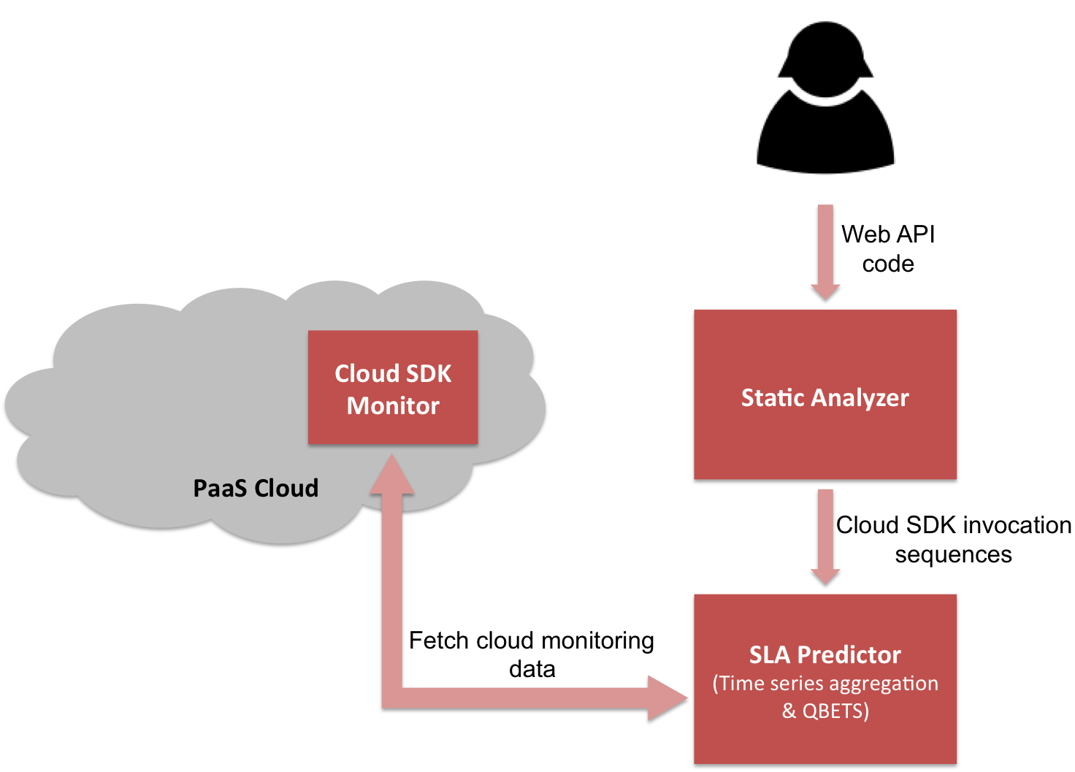
Cerebro Architecture
Path identification via CFG
SLO Predictor
API responds under Q ms, p% of the time
Notes:
Where’s the static analyzer running?
Explain the intuition – apps spend most of their time on PaaS SDK
Worst-case path identification
Loops
60s default deadline

Slide 21
SLO Durability
Suppose Cerebro predicts that some API responds under Q ms, 95% of the time
Probability of observing 3 consecutive readings greater than Q: 0.05³ = 0.000125
Each time Cerebro makes a prediction, it computes the autocorrelation in the time series
Autocorrelation can be used to lookup a table, and determine C_{w}; the number of consecutive readings greater than Q, that constitute a change point

Slide 22
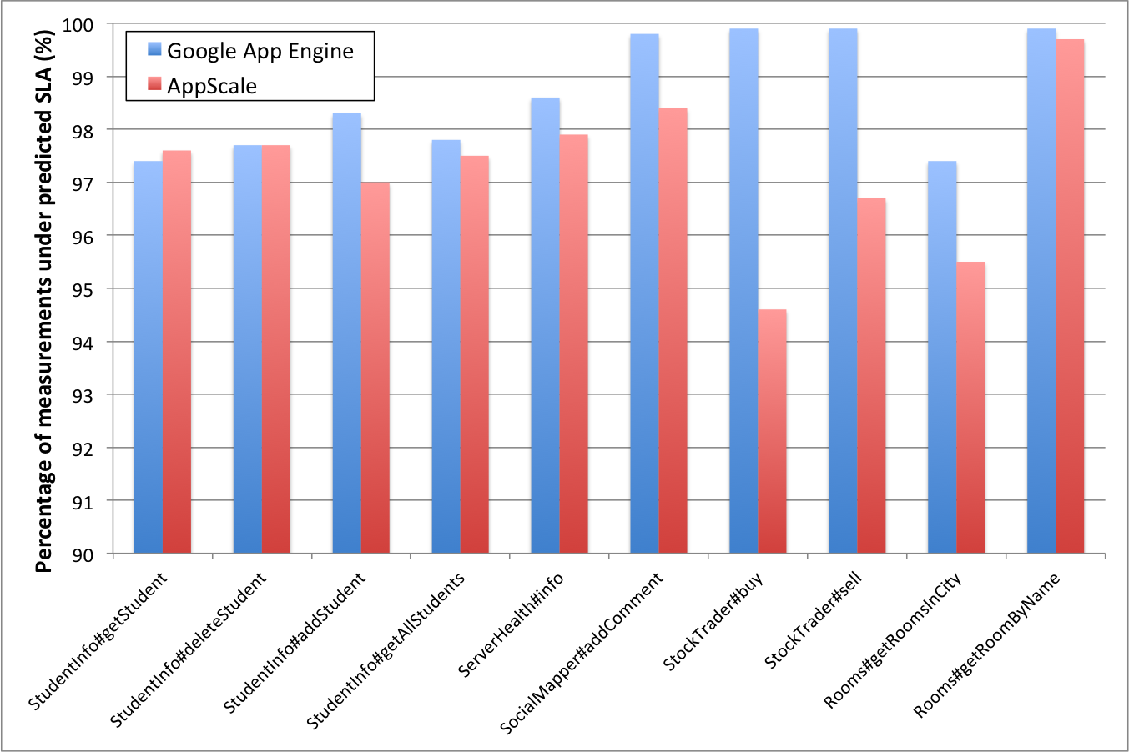
Prediction Correctness
Notes:
94.6 rounds to 95
Runs on both AppEngine and AppScale (both private and public)
Discuss the anomaly fast

Slide 23
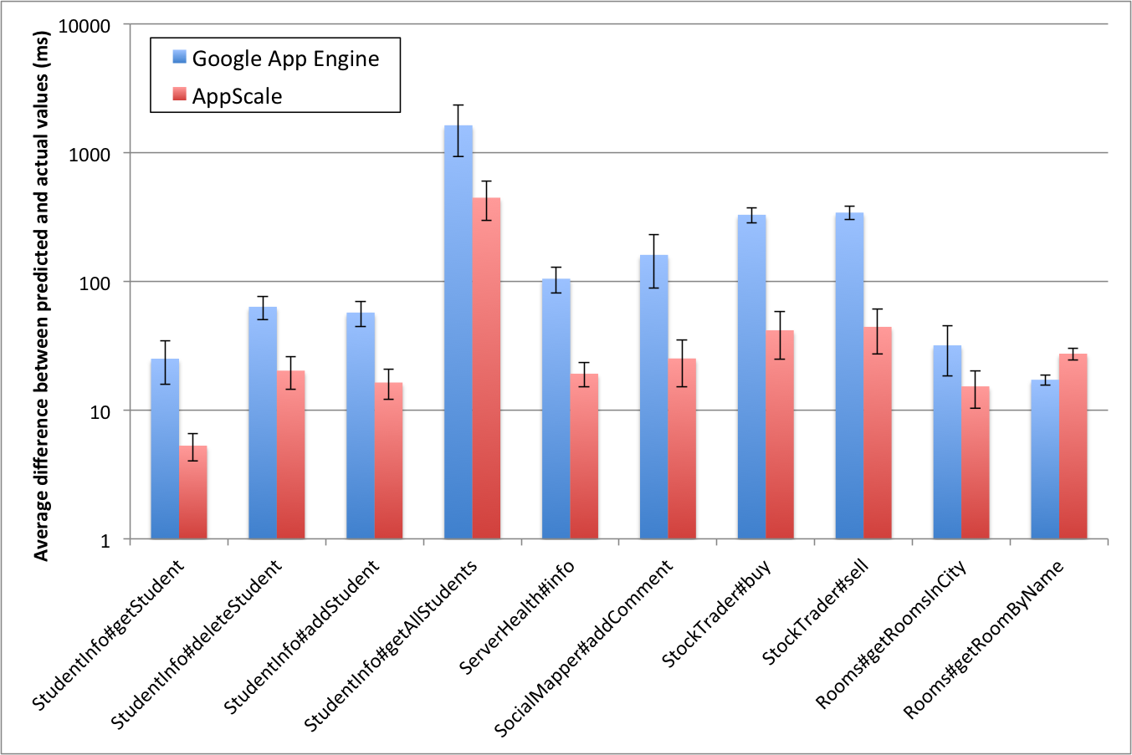
Prediction Tightness

Slide 24
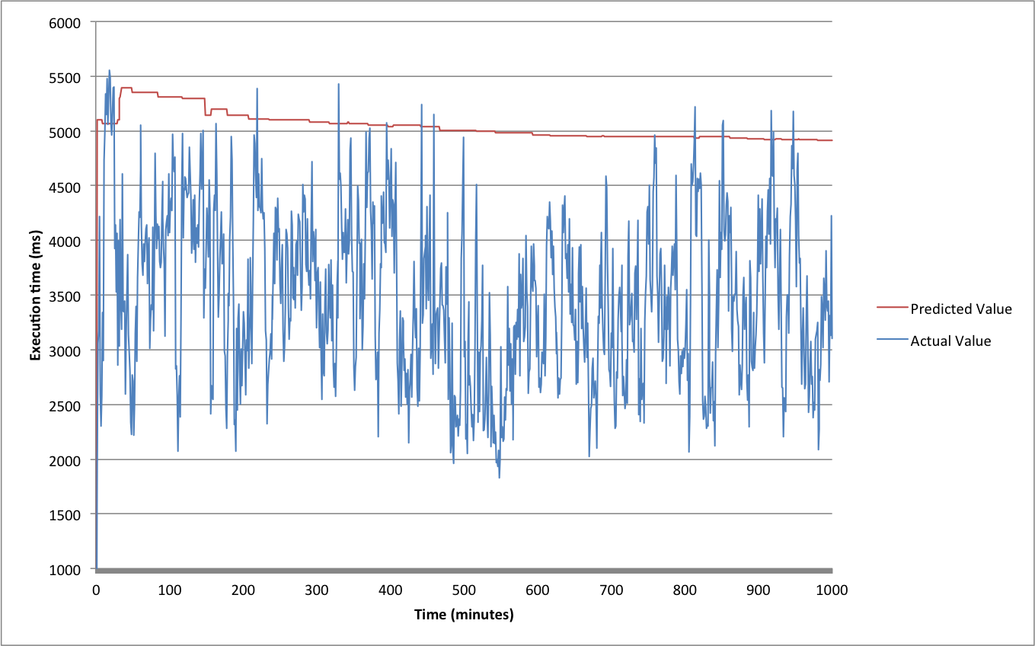
Correctness vs Tightness

Slide 25
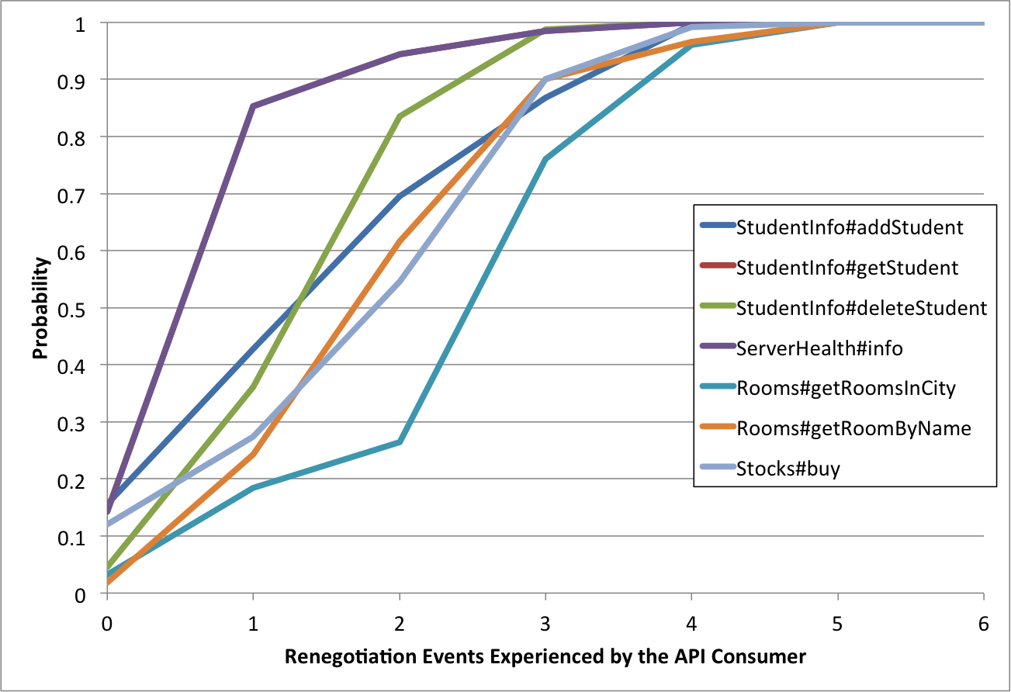
SLO Renewals Per User
Based on simulation results on Google App Engine for 125,000 users for 112 days.
Minimum average SLO durability: 12 days
Notes:
Set the requirement up. SLO needs to be valid for long periods

Slide 26
Research Contributions
Low-overhead governance framework for cloud platforms that enforces best practices via policies
Methodology for automatically stipulating performance SLOs for cloud applications
Monitoring framework for detecting performance SLO violations, and diagnosing root causes

Slide 27
Roots
An extensible framework for detecting performance SLO violations, anomalies and diagnosing potential root causes
Full-stack monitoring without instrumenting application code
Support multiple methods to analyze the collected data in near real-time
H. Jayathilaka, C. Krintz and R. Wolski, “Performance Monitoring and Root Cause Analysis for Cloud-hosted Web Applications” under review at World Wide Web Conference 2017 (WWW).
H. Jayathilaka, C. Krintz and R. Wolski, ”Bottleneck Identification in Cloud-hosted Web Applications,” under review at IEEE Transactions on Cloud Computing (TCC).
Notes:
A monitoring and diagnostic framework built into PaaS clouds.
It supports application monitoring as another fundamental service offered by the cloud platform. Therefore it doesn’t require any third party monitoring tools.
Roots does not require instrumenting application code. Instead it collects data from within the cloud platform, by directly integrating with the major components of the cloud platform that are involved in application request processing.
We have designed Roots as en extensible framework so it can support different methods and algorithms for analyzing the collected data.

Slide 28
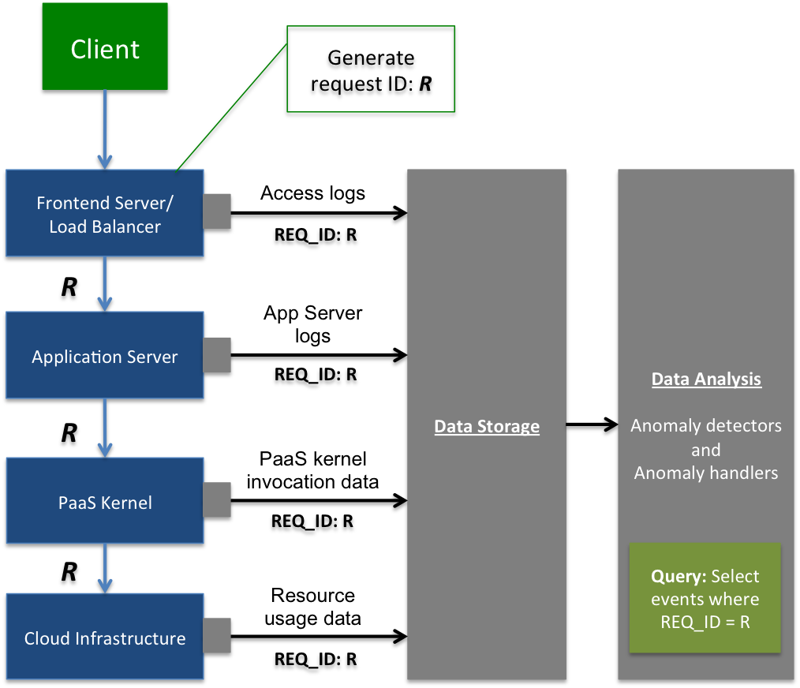
Roots Architecture
Pod
Notes:
Use existing tools/methods
Implement a framework that allows using different methods and test them
LB metadata injection is normal

Slide 29
Detecting SLO Violations
Benchmark applications (APIs) at regular intervals to measure their response time
Periodically assess the proportion of measurements that are below a preconfigured threshold (the SLO)
Raise an alarm if the SLO has been violated
Notify users
Trigger root cause analysis

Slide 30
Root Cause Analysis
Step 1: Workload analysis
Detect change points (level shifts) in workload
Sudden increases in workload that precede a detected SLO violation
Pruned Exact Linear Time (PELT) [KFE12]
Step 2: Bottleneck identification
Hybrid approach that combines linear regression and quantile analysis
Notes:
Define workload
If workload change detected, that’s the root cause
Discuss citation

Slide 31
Linear Regression
protected void doGet(HttpServletRequest req, HttpServletResponse res) { String userId = req.getParameter("user"); Entity entity = datastore.get(newKey("USER_INFO", userId)); // X populateResponse(userId, entity, res); Entity userEvent = new Entity("USER_EVENT"); userEvent.setProperty("user", userId); userEvent.setProperty("date", System.currentTimeMillis()); datastore.put(userEvent); // Y }
Model total response time using multiple linear regression (Total = X + Y)
Relative importance metric indicates the portion of variance in “Total” explained by each independent variable [G06]
Notes:
Handles multicolinearity
Looks for most variance

Slide 32
Quantile Analysis
For each kernel invocation made by an API (e.g. X and Y), compute and compare the high quantiles (e.g. 0.99 quantile)
Detecting the operation that is generally slow
For each kernel invocation, check for tail-end values that exceed the 0.99 quantile
Detecting rare, high-valued outliers
Notes:
Looks for most deviant (outliers)

Slide 33
Diagnosis Accuracy
StockTrader app
8 kernel invocations per request
Faults injected every two hours
Slowing the 1st invocation
Slowing the 2nd invocation
Notes:
Query == invocation

Slide 34
Diagnosis Accuracy
Faulty Node
G1
G8
G2
G4
G3
G4
G6
G5
G7
G6
G7
G1
G8
G2
G3
G5
Notes:
Anomalies are “only” detected from the apps in faulty node

Slide 35
Workload Change Analysis

Slide 36
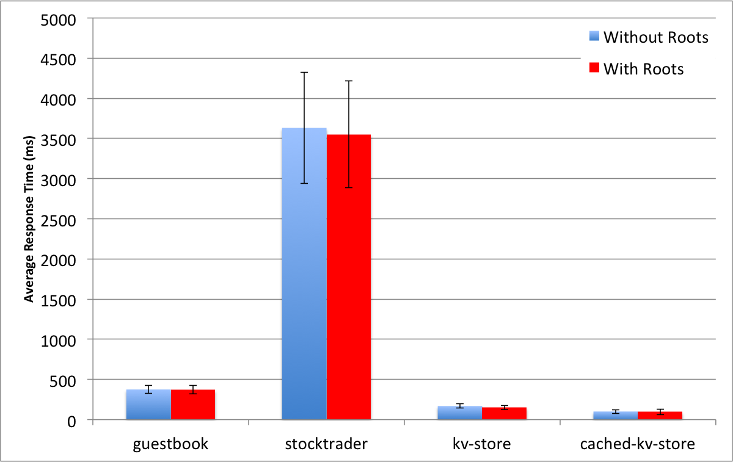
Roots Performance Impact
Notes:
Diagnosis can be performed after the fact
Don’t want to perform heavy ops at runtime

Slide 37
Roots Scalability (Pod-level)
Pod deployed on a quad-core, 2GB virtual machine.
Able to run 40,000 concurrent detectors before hitting CPU limit.

Slide 38
Overall Summary
Scalable deployment-time governance and policy enforcement framework for cloud platforms, complete with a policy specification language
Mechanism for formulating correct, tight and durable performance SLOs for cloud applications, with SLO invalidation and renewal
Scalable cloud application platform monitoring for detecting performance SLO violations, and conducting root cause analysis
EAGER
Cerebro
Roots

Slide 39
Conclusions
Efficient and automated governance in cloud environments is both feasible and effective
The resulting solutions enable achieving:
Administrative conformance
Developer best practices
Performance SLOs
Governance can be implemented as a native service in existing cloud platforms
Policy enforcement, SLO prediction and performance debugging as built-in capabilities
Notes:
At the beginning of this presentation we posed the question, whether it is possible to implement efficient, automated governance in cloud platforms in order to achieve administrative conformance, developer best practices and performance SLOs.
What we have found in our research is that efficient and automated governance is not only feasible, but also highly effective at achieving these 3 goals in cloud platforms.
We also learned that governance can be implemented in cloud platforms that already exist. At no point, we had to build our own cloud platform from the scratch to validate our work. We were always able to integrate our governance mechanisms with existing production cloud platforms like App Engine and AppScale.
What this means is that features like policy enforcement, SLO prediction and performance debugging can be supported in the cloud without the application developer from having to do anything extra, or them having to use any third party tools.
Therefore we think that our findings will drive cloud providers to improve their cloud platform implementations, and provide more feature rich, and more competitive offerings to their user communities.
That would in turns make cloud platforms more user-friendly and more dependable for application developers, and more maintainable for cloud providers.

Slide 40
Related Work
H. Jayathilaka, C. Krintz and R. Wolski, ”Towards Automatically Estimating Porting Effort Between Web Service APIs” IEEE International Conference on Services Computing 2014 (SCC).
H. Jayathilaka, A. Pucher, C. Krintz and R. Wolski, ”Using Syntactic and Semantic Similarity of Web APIs to Estimate Porting Effort” International Journal of Services Computing, 2014, vol 2, issue 4
C. Krintz, H. Jayathilaka, S. Dimopoulos, A. Pucher, R. Wolski and T. Bultan, "Cloud Platform Support for API Governance” IEEE International Conference on Cloud Engineering 2014 (IC2E).
H. Jayathilaka, C. Krintz and R. Wolski, "EAGER: Deployment-Time API Governance for Modern PaaS Clouds” IEEE International Conference on Cloud Engineering 2015 (IC2E).
H. Jayathilaka, C. Krintz and R. Wolski, “Response Time Service-Level Agreements for Cloud-hosted Web Applications”, 2015 ACM Symposium on Cloud Computing (SOCC)
H. Jayathilaka, C. Krintz and R. Wolski, "Service-Level Agreement Durability for Web Service Response Time" 2015 IEEE 7th International Conference on Cloud Computing Technology and Science (CloudCom)
H. Jayathilaka, C. Krintz and R. Wolski, “Performance Monitoring and Root Cause Analysis for Cloud-hosted Web Applications” under review at World Wide Web Conference 2017 (WWW).
H. Jayathilaka, C. Krintz and R. Wolski, ”Bottleneck Identification in Cloud-hosted Web Applications” under review at IEEE Transactions on Cloud Computing (TCC).
[JBW08] D. Nurmi, J. Brevik and R. Wolski, “QBETS: Queue Bounds Estimation from Time Series”, 2008 International Conference on Job Scheduling Strategies for Parallel Processing
[KFE12] R. Killick, P. Fearnhead and I.A. Eckley, “Optimal Detection of Changepoints with a Linear Computational Cost”, Journal of the American Statistical Association, 2012, vol 107, issue 500
[CL93] C. Chen and L. Liu, “Joint Estimation of Model Parameters and Outlier Effects in Time Series”, Journal of the American Statistical Association, 1993, vol 88, issue 421

Slide 41
Related Work
[G06] U. Gromping, “Relative Importance for Linear Regression in R”, Journal of Statistical Software, 2006, vol 17
[IHE15] O. Ibidunmoye, F. Hernandez-Rodriguez and E. Elmroth, “Performance Anomaly Detection and Bottleneck Identification”, ACM Computing Surveys, 2015, Vol. 48
D. Nurmi, R. Wolski, C. Grzegorczyk, G. Obertelli, S. Soman, L. Youseff, and D. Zagorodnov, “The Eucalyptus open-source cloud-computing system”, In IEEE/ACM International Symposium on Cluster Computing and the Grid, 2009
C. Krintz, “The AppScale Cloud Platform: Enabling Portable, Scalable Web Application Deployment”, IEEE Internet Computing, 2013.
S. Bygde. Static WCET analysis based on abstract interpretation and counting of elements. PhD thesis, Ma ̈lardalen University, 2010.
S. Gulwani, S. Jain, and E. Koskinen. Control-flow Refinement and Progress Invariants for Bound Analysis. In ACM SIGPLAN Conference on Programming Language Design and Implementation, 2009
R. Vallee-Rai, L. Hendren, V. Sundaresan, P. Lam, E. Gagnon and P. Co, “Soot – A Java Optimization Framework”, CASCON 1999.
R. T. Fielding. Architectural Styles and the Design of Network-based Software Architectures. PhD thesis, University of California, Irvine, 2000
L. Wu, S. Garg, R. Buyya, C. Chen, and S. Versteeg. Automated SLA Negotiation Framework for Cloud Computing. In IEEE/ACM International Symposium on Cluster, Cloud and Grid Computing, 2013
R. Killick and I.A. Eckley, “Changepoint: An R Package for Changepoint Analysis”, Journal of Statistical Software, 2014, vol 58, issue 3
A. Iosup, N. Yigitbasi, and D. Epema, “On the Performance Variability of Production Cloud Services,” in Cluster, Cloud and Grid Computing (CCGrid), 2011 11th IEEE/ACM Inter- national Symposium on, 2011
S.Duan and S.Babu,“Proactive Identification of Performance Problems,” in ACM SIGMOD International Conference on Management of Data, 2006

Slide 42
Request ID generation,
Response time measurement
SDK call tracing,
SDK call time measurement
Loadbalancer
App Server
PaaS SDK
Path Analysis
Anomaly Detection
Root Cause Analysis

Slide 43
Path Analysis
Compute the distribution of requests over different paths
Evaluate how this distribution changes over time
Novelty detection – appearance of new paths in the path distribution
Summarize response time metric over different paths

Slide 44

EAGER Prototype
Implemented into AppScale
http://appscale.com
Metadata Manager – MySQL
API Gateway and Discovery Portal – WSO2
All additional processes integrated into the task management subsystem of AppScale
Minimal code changes/additions

Slide 45
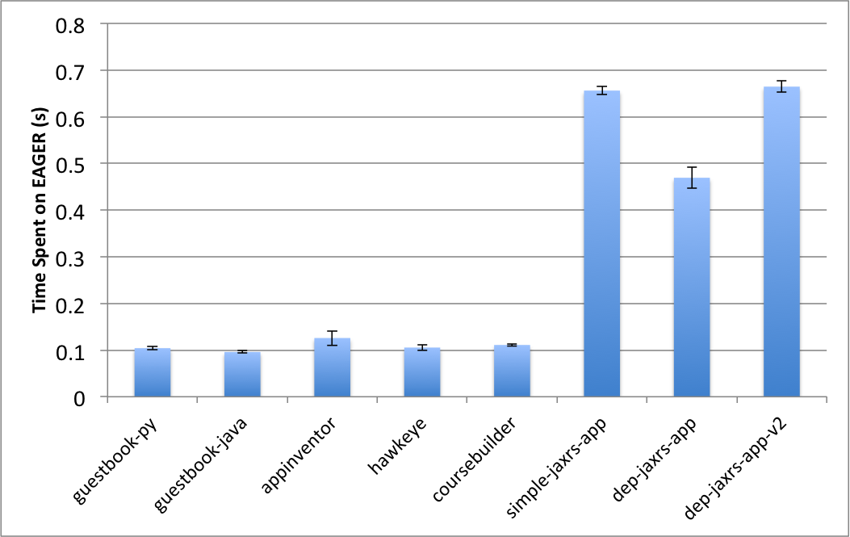
EAGER Overhead by App

Slide 46
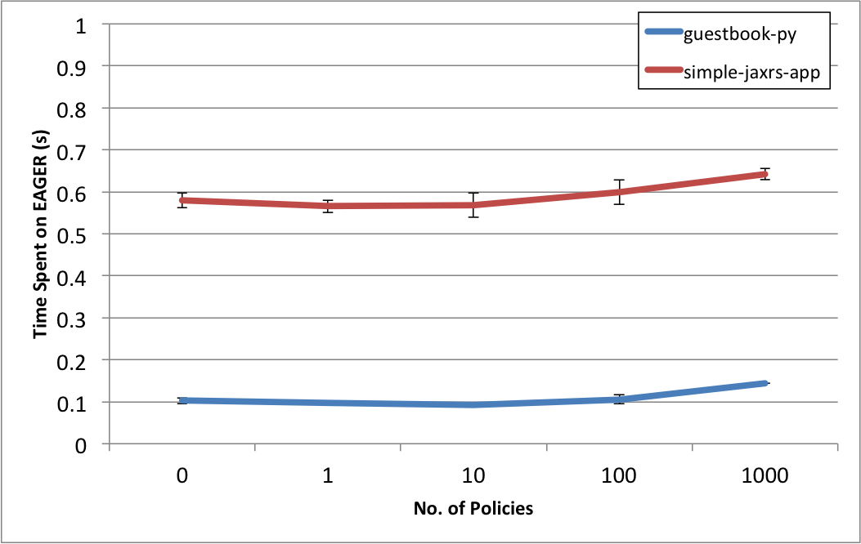
EAGER Overhead vs Policies

Slide 47
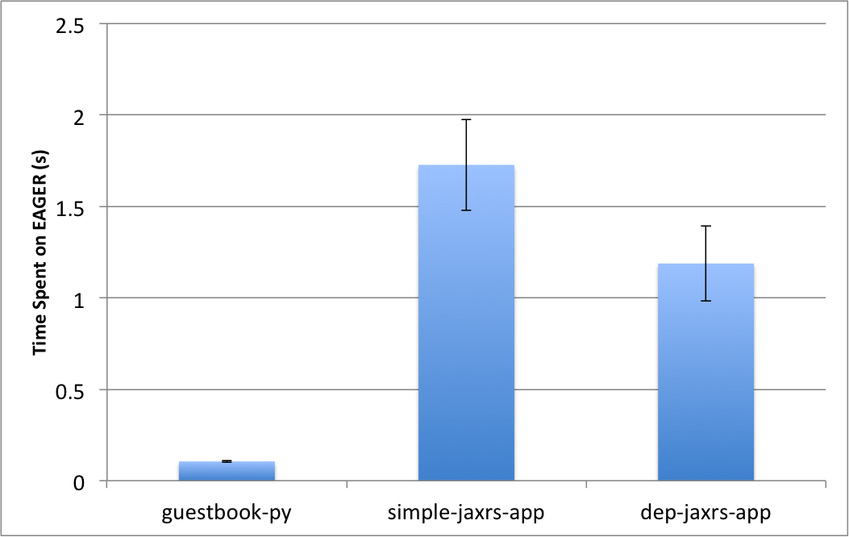
ProgrammableWeb Dataset
0 policies; 18322 APIs in DB; 33615 dependency edges

Slide 48
QBETS: Queue Bounds Estimation from Time Series
Analyzes the first n entries in a time series
Predicts an upper bound for the (n+1)^{th} entry
QBETS([x₁,x₂,…x_{n}], p) = Q where p ∈ (0,1)
P(x_{n+1} ≤ Q) ≥ p
Cerebro uses QBETS to predict response time SLOs of the form:
Operation O responds under T milliseconds (100p)% of the time
D. Nurmi, J. Brevik and R. Wolski, “QBETS: Queue Bounds Estimation from Time Series”, 2008 International Conference on Job Scheduling Strategies for Parallel Processing

Slide 49
Detecting SLO Invalidation
Each time Cerebro makes a prediction, it computes the current autocorrelation in the time series
Autocorrelation can be used to lookup a table, and determine C_{w}; the number of consecutive readings greater than Q, that constitute a change point
We consider the SLO to have become invalid if this change point occurs

Slide 50
SLO Validity Periods (In Hours)
API | 5th Percentile | Mean | 95th Percentile
StudentInfo#getStudent | 12.97 | 631.24 | 1911.19
StudentInfo#deleteStudent | 7.65 | 472.07 | 2031.59
ServerHealth#info | 12.96 | 630.01 | 1911.19
Rooms#getRoomByName | 8.48 | 345.13 | 1096.53
Rooms#getRoomsInCity | 20.56 | 296.44 | 1143.45
Stocks#buy | 8.46 | 411.75 | 815.5

Slide 51
Chen & Liu Method Example
Series: ts(data)
ARIMA(0,0,0) with non-zero mean
Coefficients:
intercept LS101
50.9053 14.4054
s.e. 0.4768 0.6743
sigma^2 estimated as 22.73: log likelihood=-596.16
AIC=1198.32 AICc=1198.44 BIC=1208.22
Outliers:
type ind time coefhat tstat
1 LS 101 101 14.41 21.36
Notes:
Outlier at t = 101 detected as a Level Shift (LS).

Slide 52
Simulation Results
At t = 500, API call B starts behaving erratically causing its relative importance score to increase significantly.

Slide 53
Unresolved Issues in the Cloud
Cannot enforce developer best practices
Cannot establish performance SLOs
Poor performance debugging support
Simplified maintenance
Reliable
Dependable

Slide 54
Cerebro Results Summary
Prediction tightness (App Engine, AppScale)
Predictions off by less than 65ms for 14/20 cases
Trades off tightness for correctness when the SDK call performance is subject to high variation
Durability (App Engine)
Minimum mean validity period: 12 days
SLO changes in 3 months: 6 or less
Execution time
10 seconds: with 24 hour history

Slide 55
Governance Framework: Goals
Code reuse
Naming and versioning conventions
Backward compatible code updates
Prevent bad code from going into production
Simple mechanism to specify conventions/policies to be enforced
Scalable, cloud-native implementation

Slide 56
Performance SLOs: Goals
Determine bounds on application response times that are:
Correct, tight and durable
No extensive testing on the applications
Automated analysis
Enforce performance policies (design-time), and detect deviations (run-time)
Notes:
Why bounds? To form SLAs

Slide 57
Monitoring Framework: Goals
Detect performance SLO violations in near real time
Check if the application performance is correlated with the workload
Diagnose bottlenecks in the cloud platform
No invasive application instrumentation
No additional restrictions on application code

